Slide 1
Project implementation
Team ID : PNC-50
Team Lead: Aditya Mane
Team Member: Pranit Gore

Slide 2
Recap of previous week
Completed data labelling (Z, O, N, F, S) using CHB-MIT EEG Dataset
Implemented pre-processing pipeline (filtering, segmentation, normalization)
Feature engineering for traditional ML models ( mean, power bands, entropy)
Started initial model experiments using Random Forest, SVM, XGBoost and CNN

Slide 3
Model building
This week was completely dedicated to model building for both Machine Learning and Deep Learning.
We implemented 13 statistical + frequency features in each model :
Mean
Variance
Line Length
Delta Power, Theta Power, Alpha Power and Beta Power
Sample Entropy
Activity
Mobility
Complexity
Skewness
Kurtosis

Slide 4
Machine learning progress
We trained and validated following ML models individually on full feature sets:
Random Forest
Extra Trees
SVM
Logistic Regression
Decision Trees
Naïve Bayes
K-Nearest Neighbours
Gradient Boosting
XG Boost
MLP Classifier
Voting Ensemble
Quadratic Discriminant Analysis

Slide 5
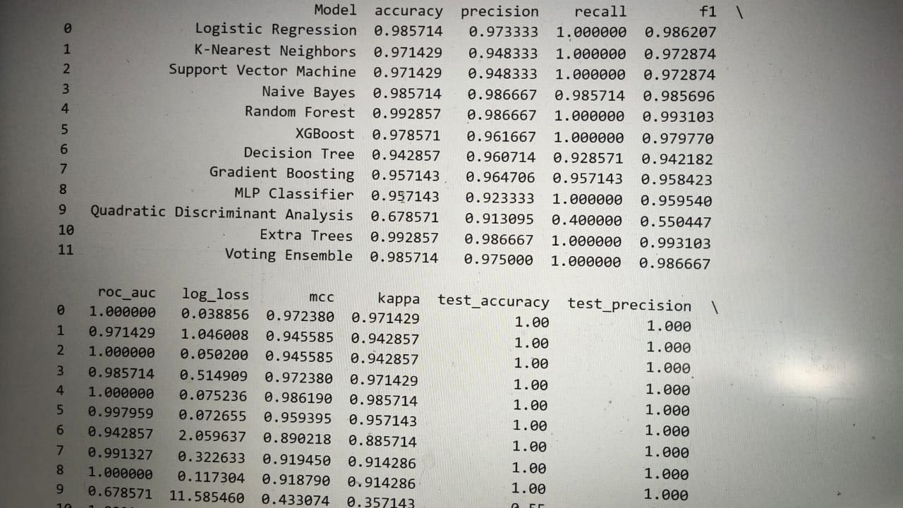
Results for ml model training

Slide 6
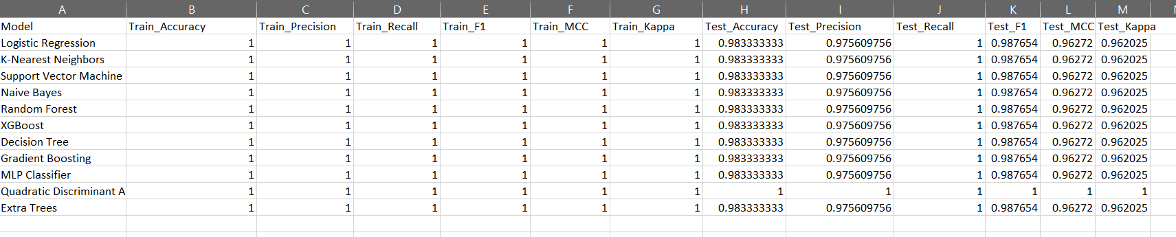
Zo vs s STFT result

Slide 7
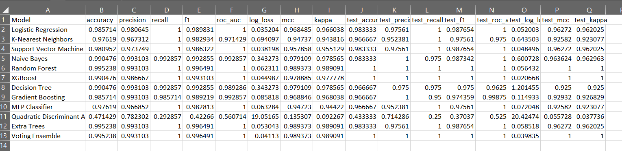
Zo vs s fft result

Slide 8
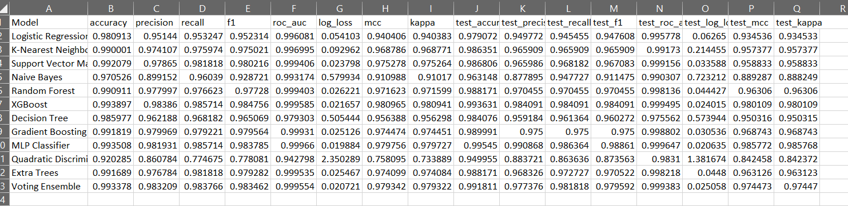
13 features s vs zofn

Slide 9
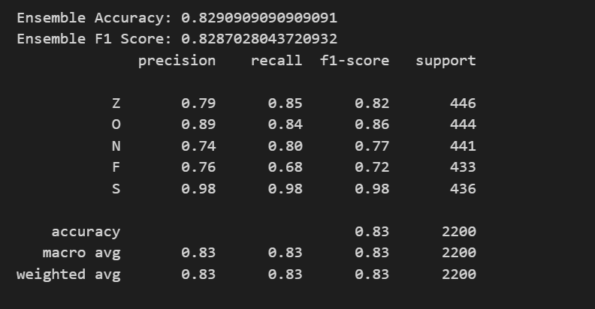
Deep learning architecture
We developed and trained advanced hybrid model using 1D-CNN + LSTM + Random Forest (Ensemble)

Slide 10
Seizure type classification
We performed classification on 9 comparison types to validate generalization:
1. Z vs N vs O vs F vs S
2. Z vs ALL
3. N vs ALL
4. O vs ALL
5. F vs ALL
6. S vs ALL
7. Z vs S
8. ZO vs S
9. ZO vs NF vs S
We noticed highest accuracy in binary models ( Z vs S , ZO vs S)
Multiclass models gave consistent performance (85- 90%)

Slide 11
Streamlit interface integration
We unified a full-stack Streamlit Application inculcating the following modules:
1. STFT Visualizer: Compare time-frequency features across multiple channels in a single patient
2. FFT Visualizer: Explore amplitude vs frequency globally
3. Seizure Predictor: User Uploads EEG file, System predicts whether seizure on non-seizure (Based on random forest trained model) and confidence score for 5-class result is displayed along with 5 types of plot chart comparison for each.
4. Visualization hub: Choose plots: Band Power, STFT Spectrogram, Power Spectral Density, etc

Slide 12
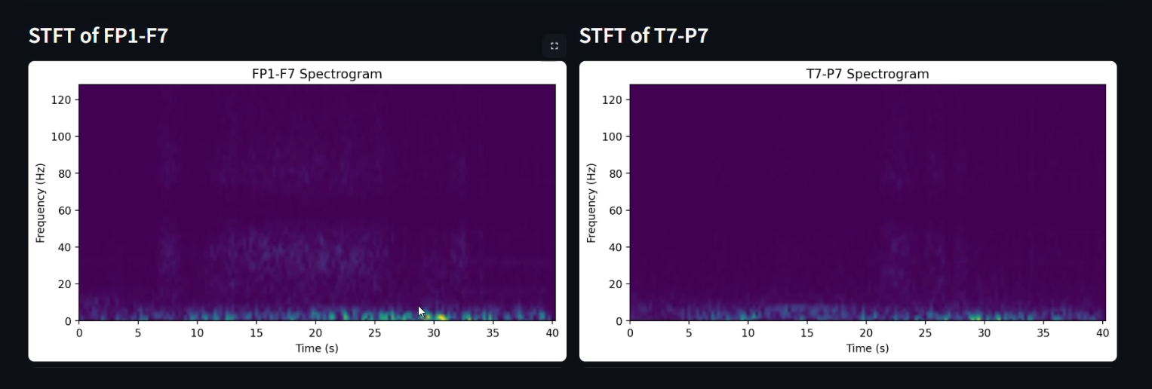
Screenshots of visualizations (1/3)

Slide 13
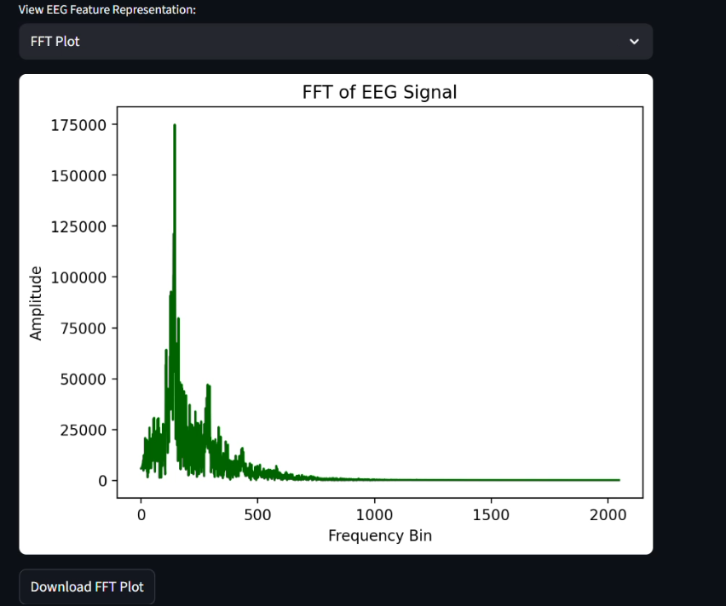
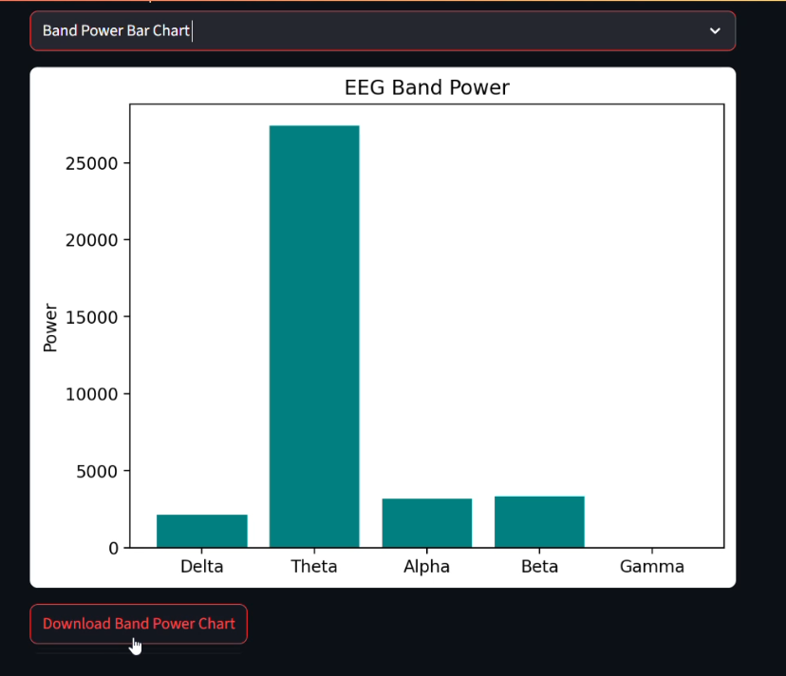
Screenshot of visualization (2/3)

Slide 14
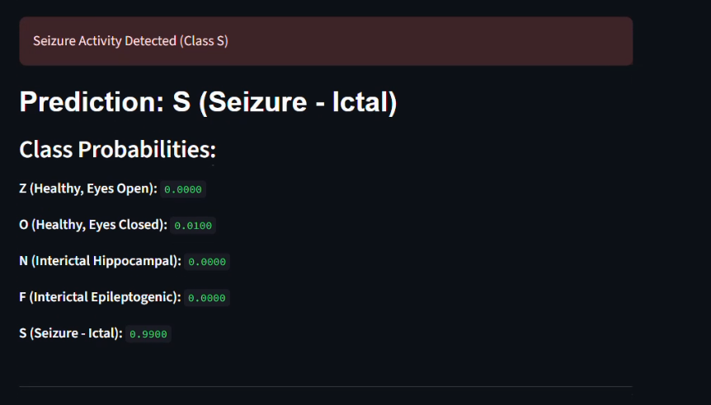
Prediction based on input data (3/3)

Slide 15
Future plan
Integrate Correlation Heatmap analysis
Enable multi-patient multi-file upload support
Consult a neurologist for prototype readiness
Deploy Streamlit App as Power BI dashboard
Draft and Submit a Research Paper

